Slide 1
Counters
Counter: A Sequential Circuit that counts pulses. Used for Event Counting, Frequency Division, Timing, and Control Operations.

Slide 2
Counter Terminology – 1
A Counter is a digital circuit whose outputs progress in a predictable repeating pattern. It advances on state for each clock pulse.
State Diagram: A graphical diagram showing the progression of states in a sequential circuit such as a counter.

Slide 3
Counter Terminology – 2
Count Sequence: The specific series of output states through which a counter progresses.
Modulus: The number of states a counter sequences through before repeating (mod-n).
Mod 2^{n} counter also called plain binary counter
Counter directions:
DOWN - count high to low (MSN to LSN)
UP - count low to high (LSN to MSN).

Slide 4
Counter Modulus
Modulus of a counter is the number of states through which a counter progresses.
A Mod-12 UP Counter counts 12 states from 0000 to 1011 or (0001) to (1100). The process then repeats.
0000 → 0001 → … → 1010 → 1011 → 0000 → …
A Mod-12 DOWN counter counts from 1011 to 0000 or (1100) to (0001), then repeats.
1011 → 1010 → … → 0001 → 0000 → 1011 → …

Slide 5
State Diagram
A diagram that shows the progressive states of a sequential circuit.
The progression from one state to the next state is shown by an arrow.
(0000 → 0001 → 0010).
Each state progression is caused by a pulse on the clock to the sequential circuit.

Slide 6
MOD 12 Counter State Diagram
With each clock pulse the counter progresses by one state from its present position on the state diagram to the next state in the sequence.
This close system of counting and adding is known as modulo arithmetic.

Slide 7
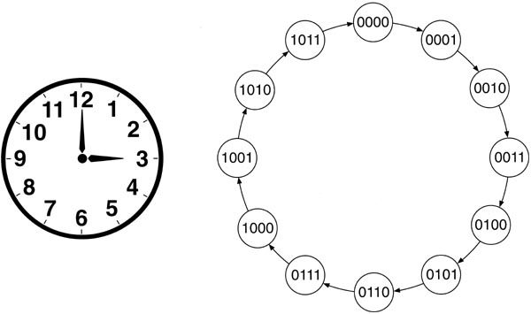
MOD 12 Counter State Diagram
clk↑
clk↑
clk↑
clk↑
clk↑
clk↑
clk↑
clk↑
clk↑
clk↑
clk↑
clk↑

Slide 8
Sequence Counters – 1
An n-bit counter that counts the maximum modulus (2^{n}) is called a full-sequence counter such as Mod 2, Mod 4, Mod 8, etc.
An n-bit counter whose modulus is less than the maximum possible is called a truncated sequence counter, such as mod 3 (n = 2), mod 12 (n = 4).

Slide 9
Sequence Counters – 2
A 4-bit mod 12 UP counter that counts from 0000 to 1011 is an example of a truncated counter.
A 4-bit mod 16 UP counter that counts up from 0000 to 1111 is an example of a full-sequence counter.

Slide 10
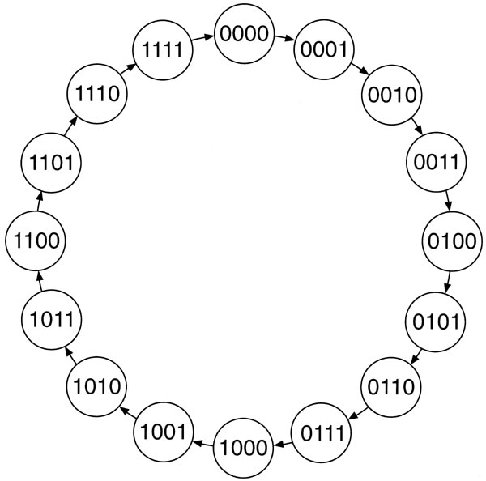
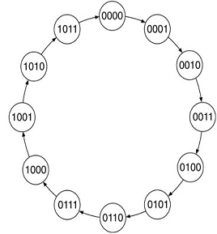
Sequence Counters – 3
Truncated
Full Sequence
Note: Clock pulse implied on transitions.

Slide 11
Counter Timing Diagrams – 1
Shows the timing relationships between the input clock and the outputs Q₁, Q₂, Q₃, …Q_{n} of a counter.
For a 4-bit mod 16 counter, the output Q₀ changes for every clock pulse, Q₁ changes on every two clock pulses, Q₂ on four, and Q₃ on 8 clocks.

Slide 12
Counter Timing Diagrams – 2
The outputs (Q₀ → Q₃) of the counter can be used as frequency dividers with Q₀ = clock ÷ 2, Q₁ = clock ÷ 4, Q₂ = clock ÷ 8, and Q₃ = clock ÷ 16.
The frequency is based on period (T ) of the output, not a transition on the output.
The same is true for a mod 12, except Q₃ = clock ÷ 12.

Slide 13
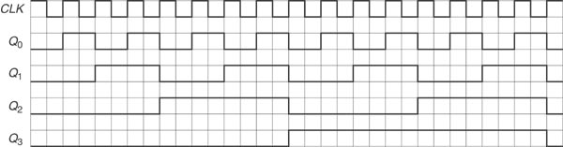
Counter Timing Diagrams – 3
Full Sequence or Truncated Sequence?
Note Q₃ symmetry

Slide 14
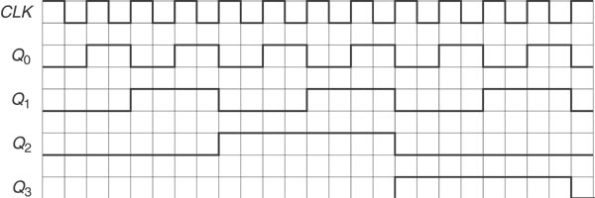
Counter Timing Diagrams – 4
Full Sequence or Truncated Sequence?
Note lack of Q₃ symmetry

Slide 15
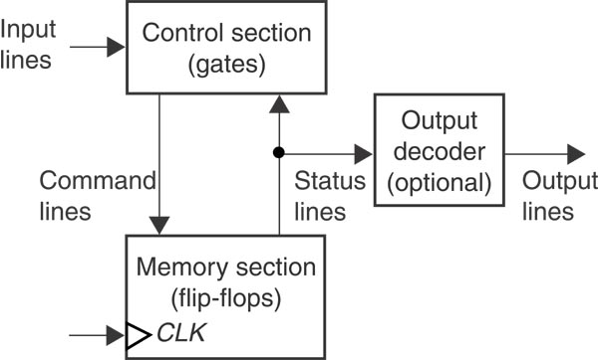
Synchronous Counters
A counter whose flip-flops are all clocked by the same source and change state in synchronization.
The memory section keeps track of the present state.
D Q
The control section directs the counter to the next state using command and status lines.

Slide 16
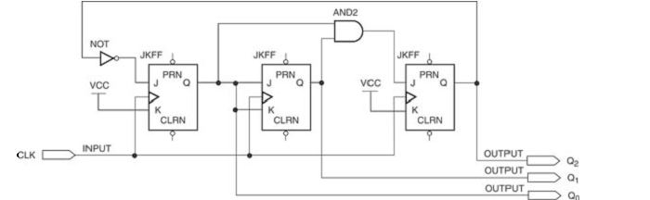
Analysis of Synchronous Counters – 1
Common Clock

Slide 17
Analysis of Synchronous Counters – 2
Set equations for the (JK, D, T) inputs in terms of the Q outputs for the counter.
Set up a table and place the first initial state in the present state column (usually all 000).
Use the initial state to fill in the Inputs that will cause this state on a clock pulse.

Slide 18
Analysis of Synchronous Counters – 3
Determine the result on each FF in the counter and place this in the next state.
Enter the next state on the present state line 2 and repeat the process until you cycle back to the first initial state.

Slide 19
State Table
Present State
Synchronous Inputs
Next State
000
01
( R )
00
(NC)
11
( T )
001
001
01
( R )
11
(T)
11
( T )
010
010
01
( R )
00
(NC)
11
( T )
011
011
11
( T )
11
(T)
11
( T )
100
100
01
( R )
00
(NC)
01
( R )
000

Slide 20
Basic Design Approach – 1
Draw a state diagram showing state changes and inputs and outputs.
Create a present/next state table.
List present states in binary order and next states based on the state diagram.

Slide 21
Basic Design Approach – 2
Use FF Excitation Tables to determine FF (JK, D, T) inputs for each present ⇒ next state transition.
If you can use a don’t care for any FF input it will help you reduce hardware size.
Specify inputs equations for each input and simplify using Boolean reductions.

Slide 22
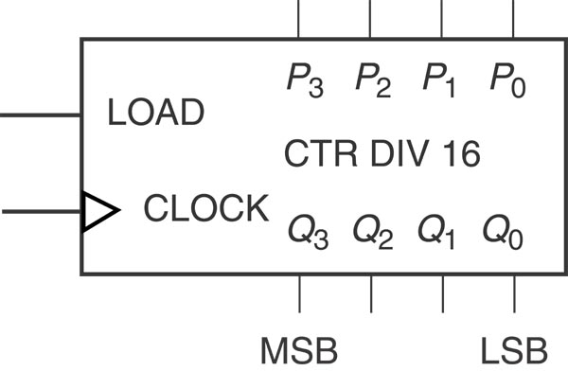
Parallel Load Counter

Slide 23
Parallel Load Counter
A preset counter (parallel load) has an additional input (load) that can be synchronous or asynchronous and four parallel data inputs.
The load pulse selects whether the synchronous counter inputs are generated by count logic or parallel load data.

Slide 24
Asynchronous load counter
An asynchronous load counter uses an asynchronous clear or preset to force the counter to a known state (usually 0000 or 1111).

Slide 25
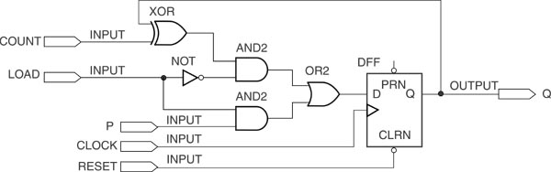
Building block of Synchronous Parallel Load Counter

Slide 26
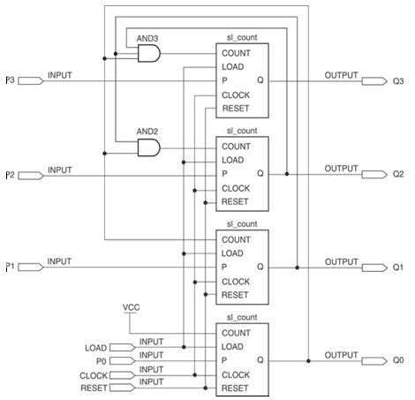
Synchronous Parallel Load Counter

Slide 27
Count Enable Logic
As shown in the previous figure, adding another AND gate to each FF input inhibits the count function.
This has the effect of inhibiting the clock to the counter (a clock pulse has no effect).
Outputs remain at the last state until the counter is enabled again.

Slide 28
Bi-Directional Counter
Adds a direction Input (DIR) to the counter and the control logic for up or down counting.
The control logic selects the up or down count logic depending on the state of DIR.

Slide 29
Terminal Count Decoding
Uses a combinational decoder to detect when the last state of a counter is reached (terminal count).
Determines a maximum count out for an UP counter and a minimum for a DOWN counter.

Slide 30
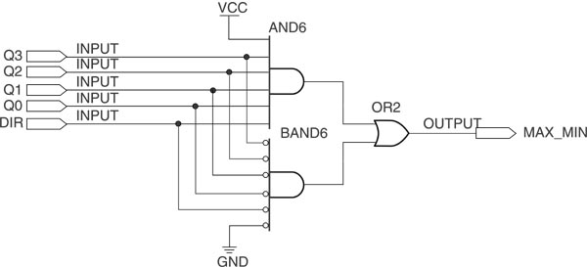
Terminal Count Decoding – 2

Slide 31
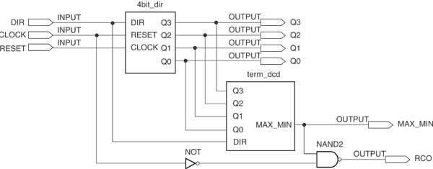
Terminal Count Decoding – 3

Slide 32
Terminal Count Decoding – 2
The terminal count decoder generates a RCO (ripple carry out) when the terminal count is reached (a high pulse for 1 clock period).

Slide 33
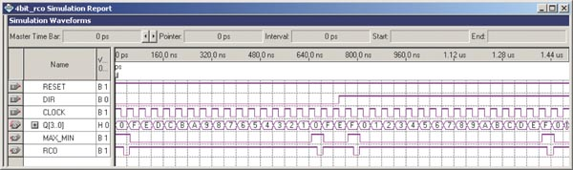
Terminal Count Decoding – 3

